Slide 1
Spacecraft Attitude Control Implementation and Development
Matthew Robinaugh
Mentor: Dr. Bradley Wall
Embry-Riddle Aeronautical University
Arizona Space Grant Symposium
4/17/2021

Slide 2
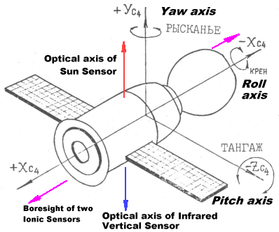


Problem Addressed
One dimensional attitude control
http://www.svengrahn.pp.se/histind/Soyuz1Land/SoyAtti.htm

Slide 3
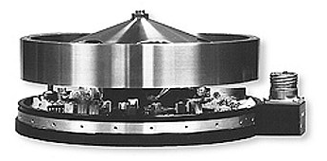
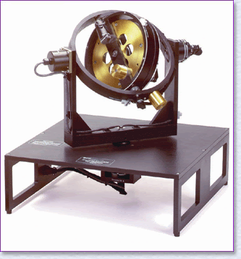
Objectives
Primary Objective: Design, code, and implement one dimensional attitude control using reaction wheel
  Goal of ±0.5°
Secondary Objective: Demonstrate control with control moment gyroscope and create platform
http://www.ecpsystems.com/controls_ctrlgyro.htm
https://en.wikipedia.org/wiki/Reaction_wheel

Slide 4
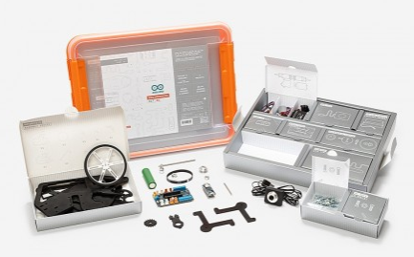
Methods
Familiarity with embedded hardware control with Arduino Engineering Kit
Designing and building spacecraft model and control using reaction wheel
https://store.arduino.cc/usa/engineering-kit-r2

Slide 5
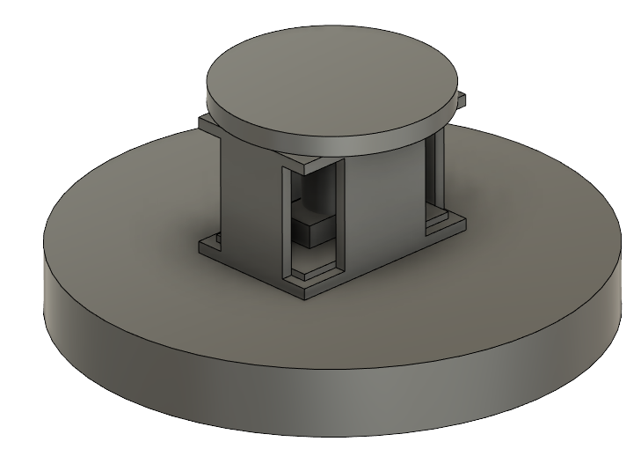
Results
Control law
Model spacecraft pointing

Slide 6
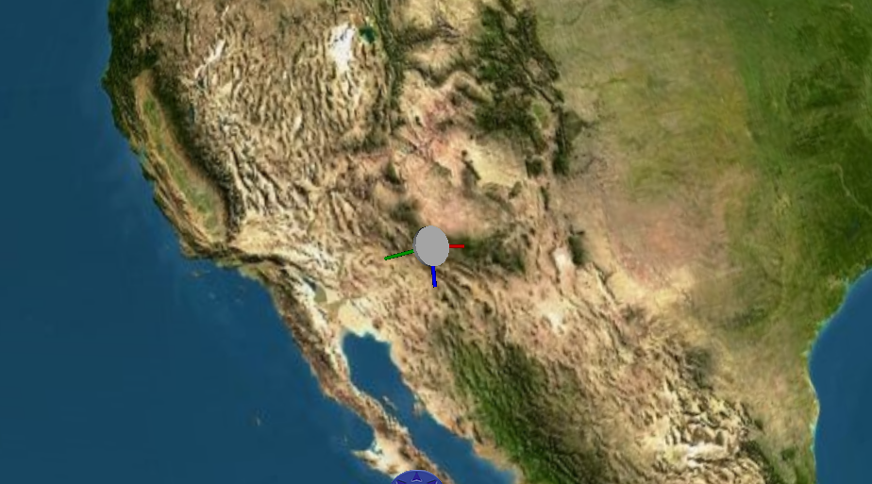
Significance
Lack of physical models and demonstrations in classes for attitude control
Providing platform for future development

Slide 7
Questions?

